Slide 1
Team 7
babysealsband.com
Sunmin Lee, Matthew Bayne, Daniel Bello, Ronald Estevez, Gregory Strakhov

Slide 2
Website Description
Baby Seals is a local band that produces experimental, free jazz music. They perform in local cafes and such. However, Baby Seals lack any sort of digital representation to advertise themselves. Our goal is to create a platform that will resolve this issue and thus allow Baby Seals to better access and develop their fan base through digital means. We shall provide easy access to all the bands info, such as tour dates, merch, about the band, and links to their music.
Our website utilizes HTML, CSS, and JavaScript in order to create a fully functional, aesthetically pleasing and well constructed page. HTML was used to insert content such as words and pictures, CSS was used to style these HTML elements, and JS was used to make these elements functional and behavioral. For example, the heading uses all three sources- HTML for the word itself, CSS for font size / style, and JS to make it change colors.

Slide 3
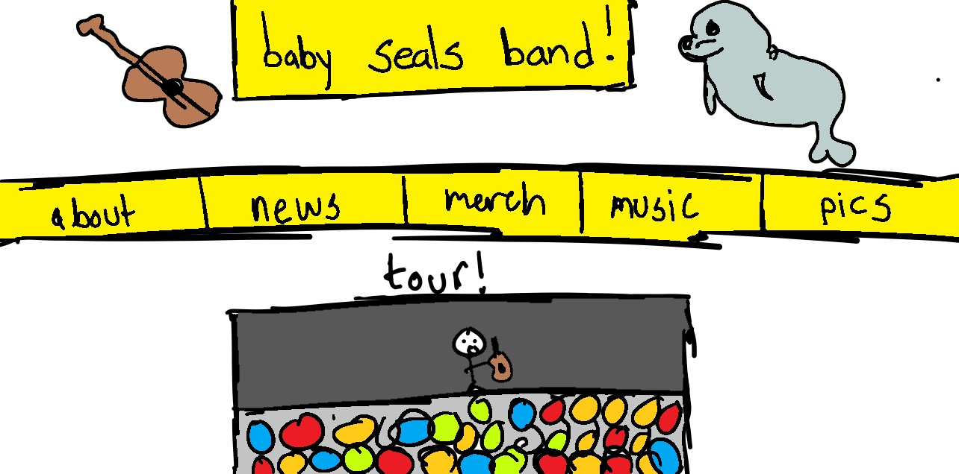
Preliminary Sketch

Slide 4
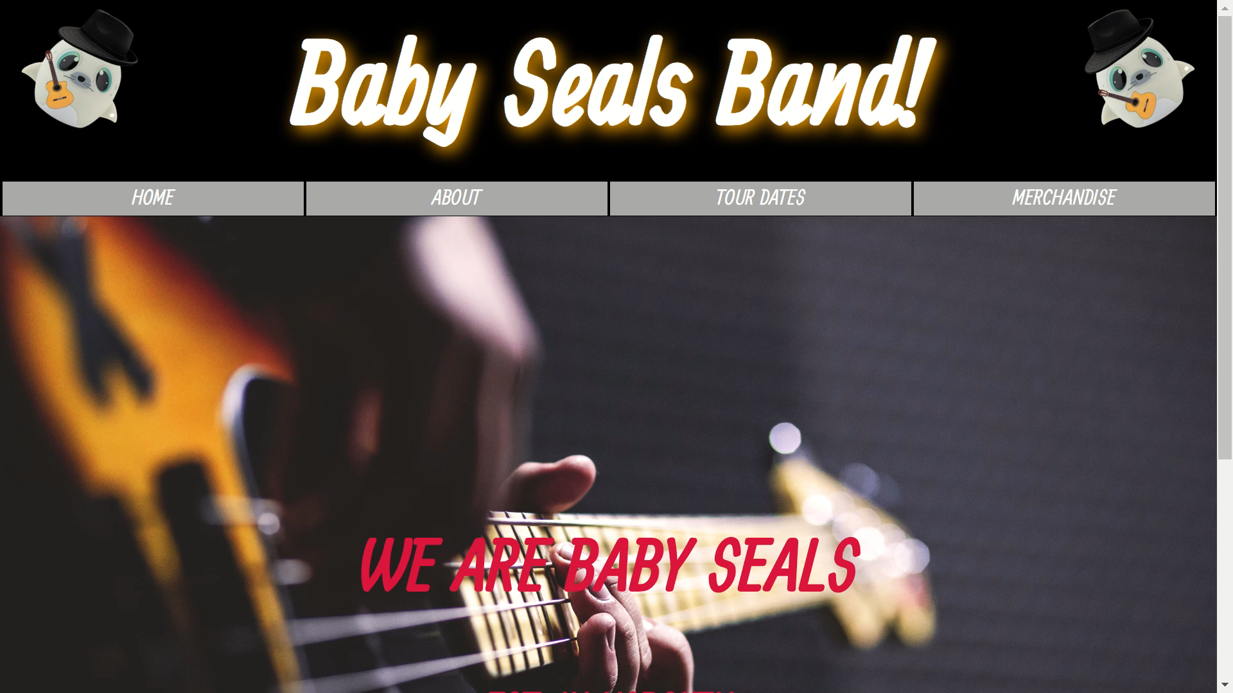
Functional Demonstration Video

Slide 5
Discussion of Choice HTML Elements
<html>
Indicates that contents within are HTML
<head>
Contains pages’ metadata (title and links to styles, fonts, and scripts)
<img>
Used to insert images into the webpages
<h1>
Indicates a first-tier heading (titles in this case)
<h3>
Indicates a third-tier heading (text over home page image in this case)
<a>
Allows hyperlinks to be embedded in text (used to link between pages)
Notes:
Describe what these elements do

Slide 6
Discussion of HTML Elements (cont’d)
<br>
Adds a line of space between elements
<p>
Used to contain bodies of text
<button>
Used to give user option to purchase merchandise or tickets
<body>
Contains all the documents HTML elements
<iframe>
Used to embed the “Spotify Music Preview” and “Follow Artist” widgets to page

Slide 7
Illustration of DOM Tree for index.html
<html>
<center>
<head>
<body>
<meta>
<link>
<link>
<script>
<title>
<link>
<img>
<h1>
<img>
<div>
<div>
<a>
<a>
<a>
<a>
<img>
<div>
<h1>
<h3>

Slide 8
Discussion of Responsive Design with CSS
The stylings default to a display suitable for computer monitors (widths greater than (768px)
Using the CSS @media rule, stylings involving text sizes are changed to accommodate different screen sizes
One set of stylingsfor viewports 480px wide or less
Another set of stylings for viewports greater than 480px but less than 768 in width
Most other sizes are specified as percentages so that they can accommodate to screens of different sizes

Slide 9
Discussion of CSS Classes and ID’s
Classes and ID’s were used to describe specific elements of the website such as…
Buttons
Navigation tabs
Logos
Titles
Certain images

Slide 10
Discussion of Choice CSS Properties
Font-family
Sets font type
Font-size
Sets font size
Color
Sets font color
Background-color
Sets background color
Position
Determines positioning of elements
Top
Determines positioning from top reference
Right
Determines positioning from left reference

Slide 11
Discussion of Choice CSS Properties (cont’d)
Height
Specifies height dimensions
Width
Specifies width dimensions
Padding
Specifies padding dimensions
Margin
Specifies margin dimensions
Text-align
Specifies whether text is right, left, or center aligned
Text-shadow
Specifies color and blur of text shadow

Slide 12
Discussion of Choice CSS Properties (cont’d)
Text-decoration
Specifies what kind of line decorates text
Max-width
Specifies a maximum allowed width
Border
Specifies border dimensions and color
Border-top
Specifies top border dimensions and color
Border-bottom
Specifies bottom border dimensions and color
overflow
Determines what is done with text that overflows

Slide 13
Discussion of Choice CSS Properties (cont’d)
Flex-basis
Specifies sizing of a flex object
Transform
Allows elements to be rotated, skewed, or scaled
Display
Specifies type of rendering box

Slide 14
Discussion of Choice JS Functionalities
Using JavaScript’s setInterval() method, a function, changeShadow(), is called upon every 750 milliseconds to alternate the text-shadow colors of the page titles between orange, cyan, and magenta
Finds titles by ID and then changes their class periodically
Like the text-shadows, the seals at the top left corners of the website’s pages are rotated and “dance” at the same beat as the text-shadow changes
Finds seals by ID and then changes their position periodically
A function called showDropDownMenu() displays a drop down menu upon clicking on the dates function of the tourDates.html page
adds functionality to clicking the dates button

Slide 15
Individual Team Member Contributions
Sunmin - reports, drop down menu for tickets, initial HTML
Matt – reports, image styling
Dan - Page formatting, some graphics, sign-up/thank you pages, initial HTML skeleton, reports
Ronald – file directory management, general maintenance and final revisions, alternating title text-shadow, navigation tabs, reports
Greg – dancing seals, responsive design, reports

Slide 16
Link to GitHub Repository
(tested on Google Chrome)
https://github.com/ronaldEstevez/babysealsband_website

Slide 17
Link to Website
https://ronaldestevez.github.io/babysealsband_website/

